Slide 1
Automation
NUNIT
PYTEST
JENKINS

Slide 2
NUNIT
Tools:
Visual Studio
Nunit Plugin
Nunit3-Console
Nunit3 Adapter
Nunit plugin (Jenkins)

Slide 3
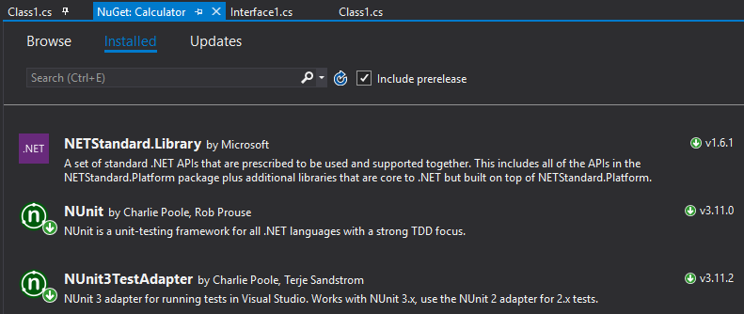
Nunit – Plugin Installation
Install package in VS Nunit from NuGet
Or from Package Manager :

Slide 4
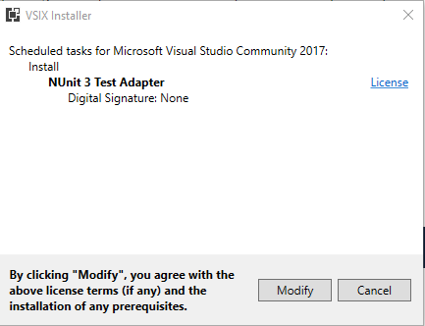
Nunit3 Adapter Plugin - installation
From Tools->Extensions and Updates
Download Nunit 3 Test Adapter
Restart VS so the application will be installed
When closing VS you will receive the follwing message: click install

Slide 5
(Nunit UUT Example (Unit UnderTest
using System;
using System.Collections.Generic;
using System.Linq;
using System.Text;
using System.Threading.Tasks;
namespace testCalc
{
public class Calc
}
public int Add(int x, int y)
}
return x + y;
{
public int Sub(int x, int y)
}
return x - y;
{
{
{
Public class – can be referenced from other Functions/Classes
Class Name
Arguments x, y To Function Add
Int – argument’s Type
Function Name
Int – Function must return Argument from type int

Slide 6
Nunit Test
Import package Nunit.Framework to be part of this script
using System;
using System.Collections.Generic;
using System.Linq;
using System.Text;
using System.Threading.Tasks;
using NUnit.Framework;
namespace testCalc
}
[TestFixture]
class Test_Calc
}
[TestCase]
public void Test_Add()
}
Calc calc = new Calc();
Assert.AreEqual(7, calc.Add(3, 4));
}
[TestCase]
public void Test_Add_Negetive()
}
Calc calc = new Calc();
Assert.AreEqual(8, calc.Add(3, 4));
}
[TestCase]
public void Test_Sub()
}
Calc calc = new Calc();
Assert.AreEqual(-5, calc.Add(3, 4));
{
}
}
Namespace identical to the UUT’s namespace
Reserved. with class, meaning the tests in this class belong to this Tests group
Reserved. with Function, meaning the Test Case
Test name, starts with “Test” (Good practice)
Function returns no arguments
Create instance of UUT Class
A Test, That check whether Calc.Add Function return “8”

Slide 7
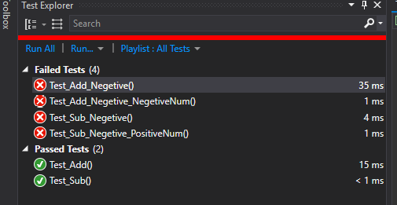
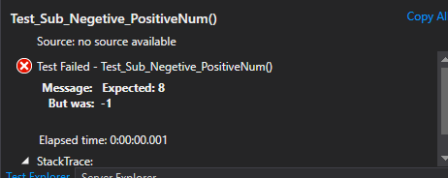
Nunit Adapter in VS
Run From VS, using Nunit3 Adapter

Slide 8
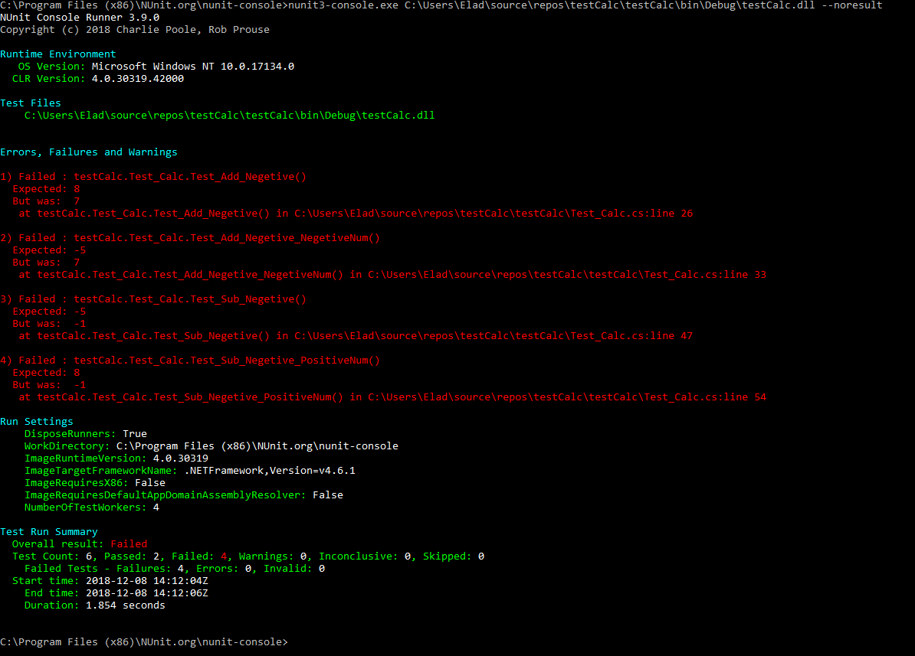
Run from nuint3-console
Download nunit3-console msi from: https://github.com/nunit/nunit-console/releases
Run C:\Program Files (x86)\NUnit.org\nunit-console>nunit3-console.exe C:\Users\Elad\source\repos\testCalc\testCalc\bin\Debug\testCalc.dll --noresult

Slide 9
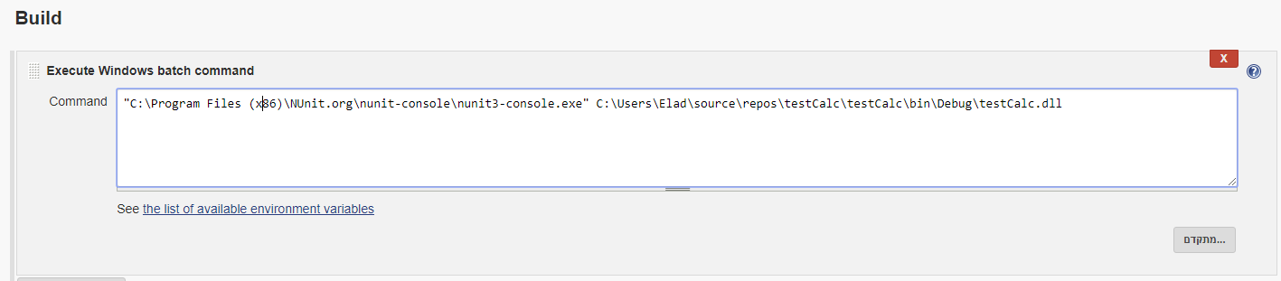
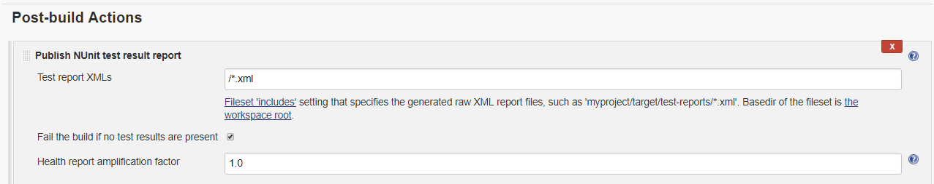
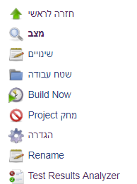
Nunit – Run From Jenkins
Install Jenkins Plugins: Test Reults Analyzer, and Nunit
Test Result Analyzer, will be added to the menu, the reports are being record and added every build run.

Slide 10
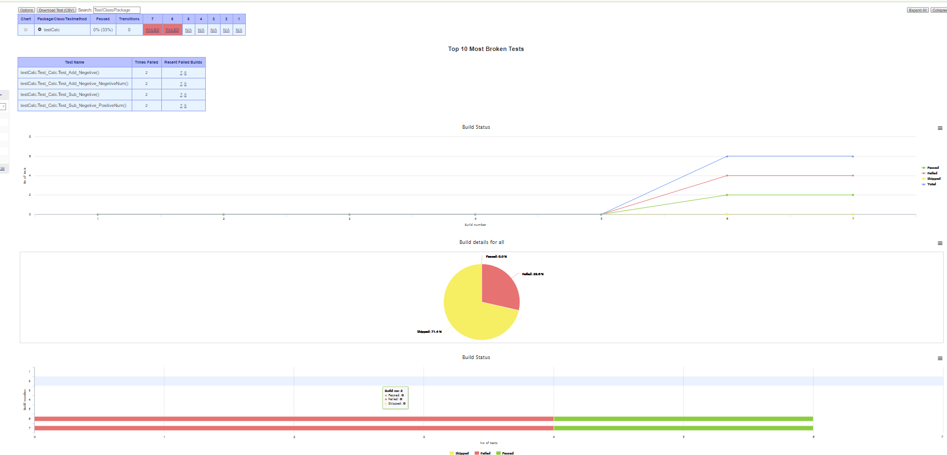
Test Result Analyzer

